Slide 1
Revisions to Retirement Plan Documents
Board of Curators
April 11, 2019

Slide 2
Timeline Recap
December 2017 Board approved investment return assumption change from 7.75% to 7.20%
April 2018 Annual benefit report to the Board highlighted timeline to develop and implement new retirement plan for new employees
November 2018 Proposed new retirement plan for new employees presented as an informational item
February 2019 Board authorized the filing of the cost statement with the Joint Committee on Public Retirement Plans and preliminarily approved the proposed new retirement plan for new employees
April 2019 Requesting final approval of the revisions to the plan documents

Slide 3
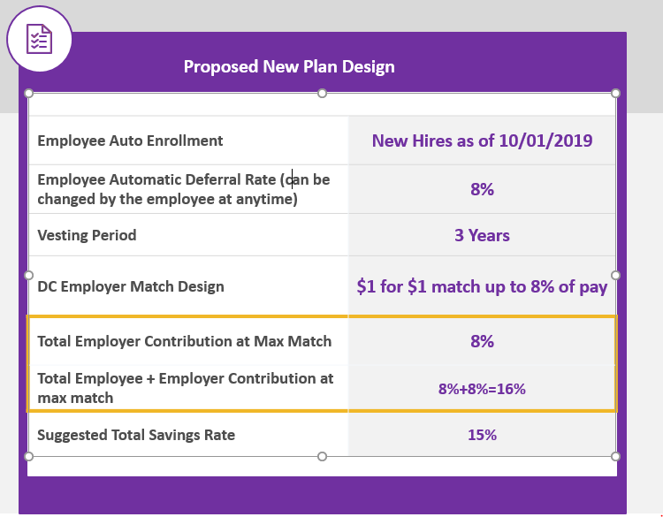
1. Introduce a new defined contribution plan to employees hired or rehired on or after October 1, 2019, and 2. Close the defined benefit plan for individuals hired or rehired on or after October 1, 2019.

Slide 4
Plan Eligibility
Newly Hired Employees – All newly hired employees on or after October 1, 2019 will be enrolled in the defined contribution plan.
Rehired Employees - All rehired employees on or after October 1, 2019 will be enrolled in the defined contribution plan.
Any benefits previously earned in the defined benefit plan will be frozen, meaning no additional service or salary credit will be earned under the defined benefit plan for former employees rehired on or after October 1, 2019.

Slide 5
Employee & University Contributions
The following applies to employees hired or rehired on or after October 1, 2019:
University Contribution Amount
100% employer match up to 8% of employee eligible compensation
Employee Automatic Enrollment Rate
Employees are automatically enrolled to defer 8% of compensation at the time of hire (can be adjusted anytime)
Employer Contribution Flexibility
Additional language regarding the University’s ability to alter the amount, design and provision of the new matching contribution in the future

Slide 6
Vesting
The following applies to employees hired or rehired on or after October 1, 2019:
3 year cliff vesting for employer contributions
Previously vested rehired employees will automatically be vested in the defined contribution plan upon rehire
Leaves will be creditable towards vesting
Prior periods of service within the last 5 years of the most recent date of hire will be considered for vesting
If a non-vested prior participant is rehired more than five years after his or her date of termination, then service credit earned before such participant's termination date will be disregarded

Slide 7
Additional Plan Enhancements
Forfeiture Language
Enhance language to further outline acceptable usage of forfeiture dollars
Loan provision – 403(b)
Add language to limit the number of active loans allowed
Mirrors current language in the 401(a) plan
Hardship provision – 403(b)
Remove 6 month suspension of elective deferrals language (IRS Rule change, required for compliance)
Final Payment to Deceased Qualified Member
Allow for final pay for deceased retirees to no longer be recalled, prorated to the date of passing and reissued, but instead to extend to the end of the month in which the retiree passes.

